Slide 1
CHILD INSURANCE MANAGEMENT SYSTEM
Rohan Patil
Yash Bora
Aparna Kumari
Jayanth G
Jyothipriya
Gopinadh

Slide 2
TEAM MEMBERS: Tech Hunters
Rohan Patil :- Backend (Parent Dashboard, Policy, Email Services),
Frontend (Parent Dashboard)
Yash Bora :- Backend (Payment Gate), Frontend (Payment Gate)
Aparna Kumari :- Backend (Registraion, Login, Plan), Frontend (Login Page)
Jayanth G :- Frontend (Parent Dashboard, Landing Page , policy Page, about us, contact us), Backend(Parent Dashboard)
Jyothipriya:- Frontend (Admin Dashboard, Login Page , Registration Page) ,
Backend (Admin Dashboard)
Gopinadh :- Frontend (Claim, contact us) & Devops Backend(Parent Dashboard)

Slide 3
Agenda
Introduction
Capstone Project Overview
Scope and Objective
Capstone Project solution design & solution implementation
Diagrams ( Architecture / Use Case /Class Diagrams / Sequence ) & Screen shots
Technology Stack
Best Practices followed during solution implementation
Challenges faced during solution design & solution implementation
Learnings & Experiences
Future Scope

Slide 4
INTRODUCTION
The Child Insurance Management System is a digital solution designed to streamline the management of child insurance policies, enabling secure policy registration, premium tracking, and claims processing while ensuring transparency, user-friendliness, and compliance with regulatory standards.
Capstone Project Overview
Full-Stack Web Application : Developed as a capstone project to integrate frontend, backend, and database technologies in a secure and scalable platform.
User Functionality : Allows parents/guardians to apply for child insurance, monitor policy status, and track premium payments.
Admin Capabilities : Enables administrators to manage user records, review applications, and handle policy decisions (approvals/rejections).

Slide 5
3. Scope and Objective
Scope
Simple registration and login
Profile management
Apply child insurance management system and track status
Admin can approve/reject insurance requests
Objective
Secure data with role-based access
Smooth on boarding and policy application process
Admin approval within 3–4 working days
Integrate with regulatory and email APIs
User-friendly dashboard for all user roles

Slide 6
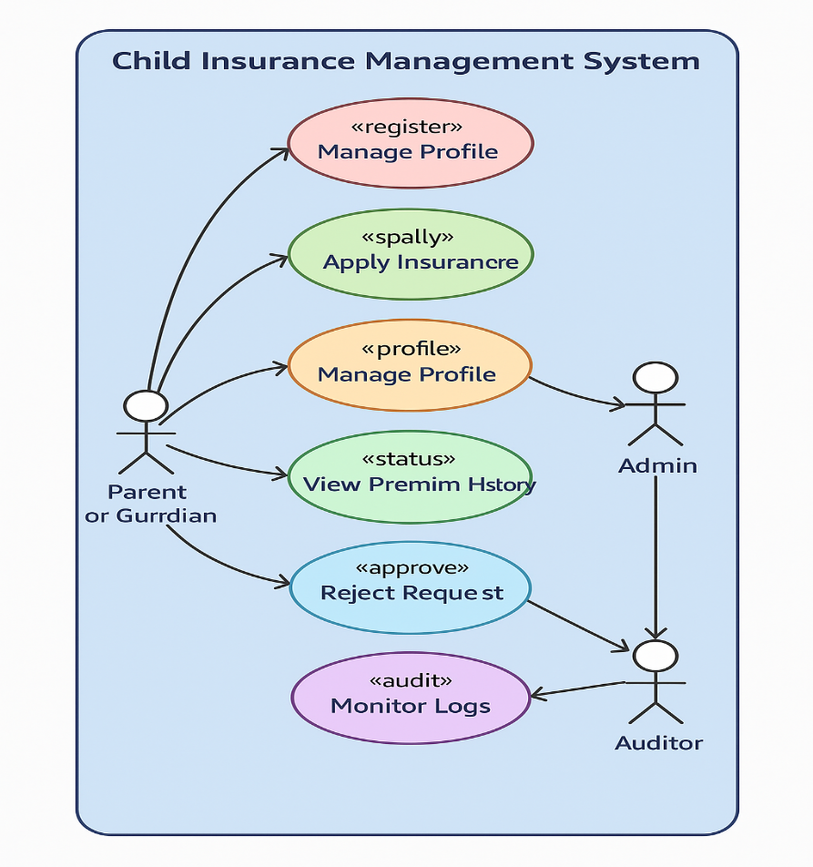
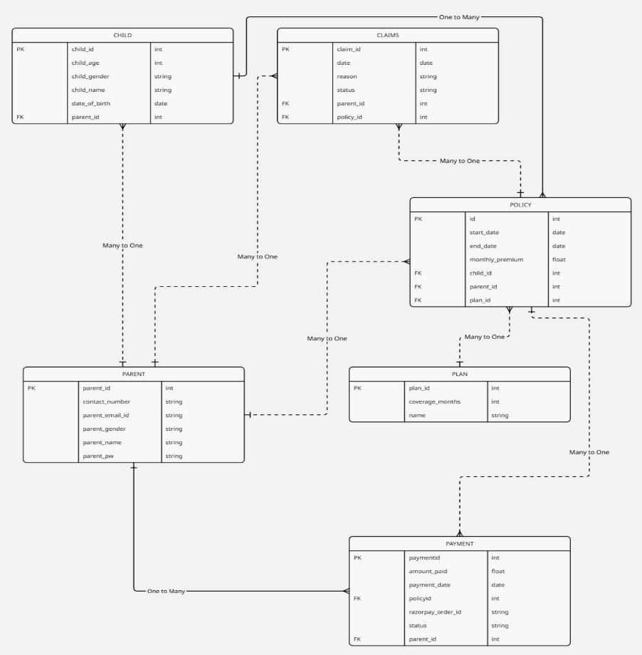
ER DIAGRAM
Use Case

Slide 7
















Technology Stack
Front end:
Back end:

Slide 8
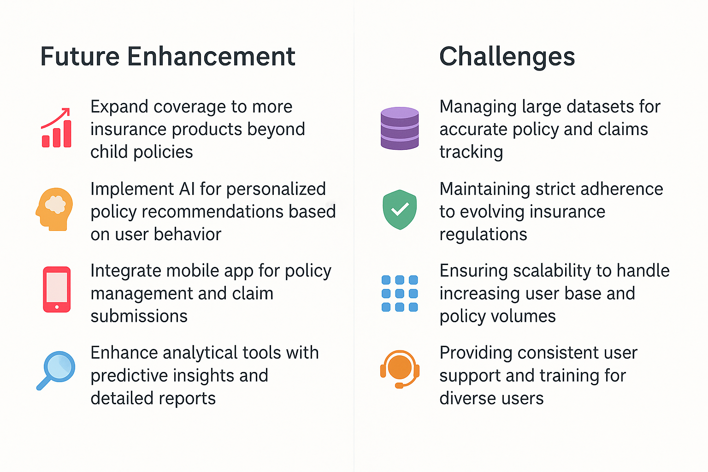

Slide 9
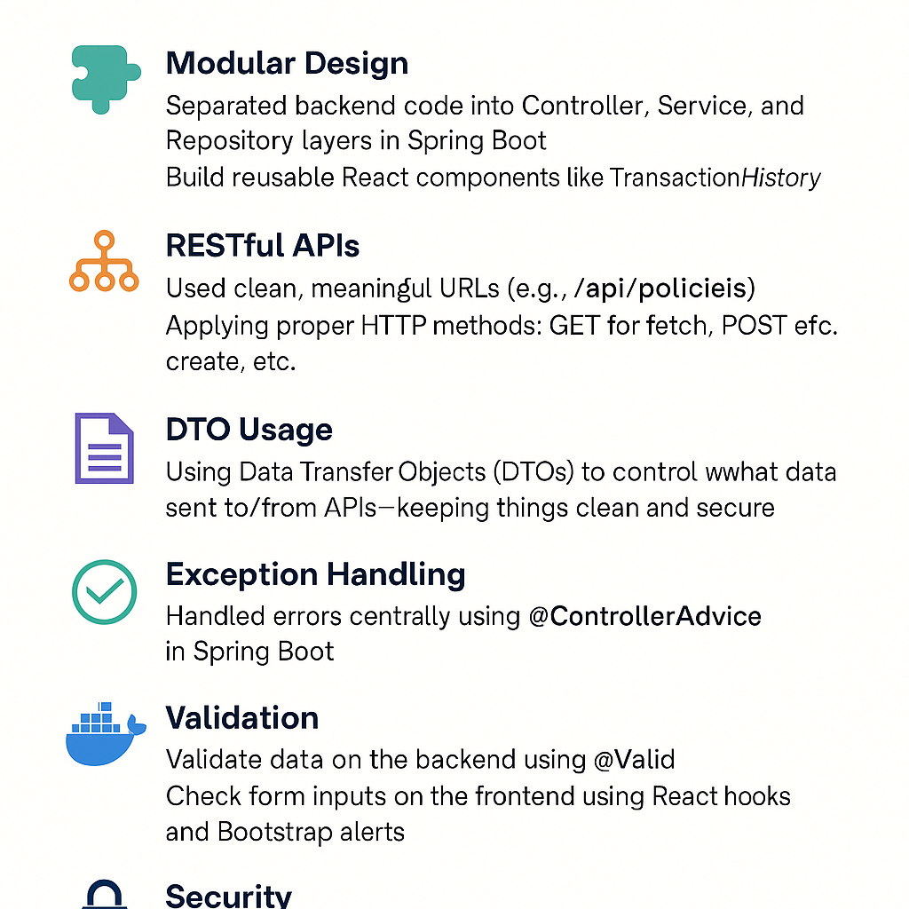
Best Practices followed during solution implementation

Slide 10

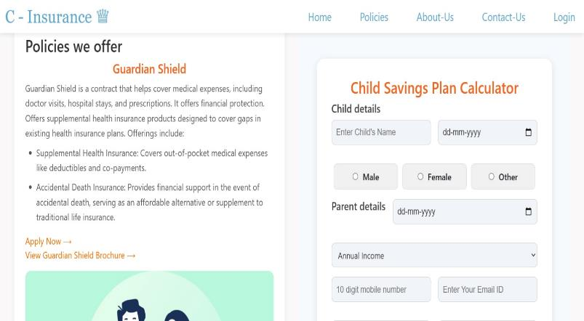

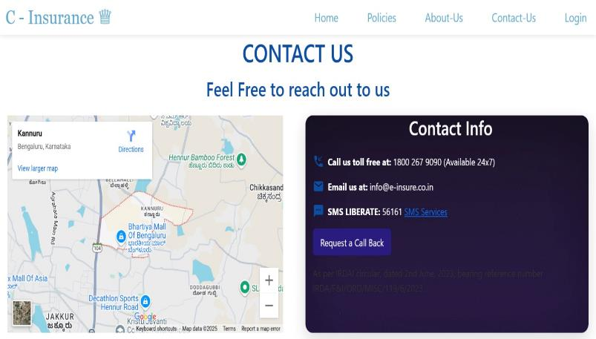
Project Pages And Flow:

Slide 11
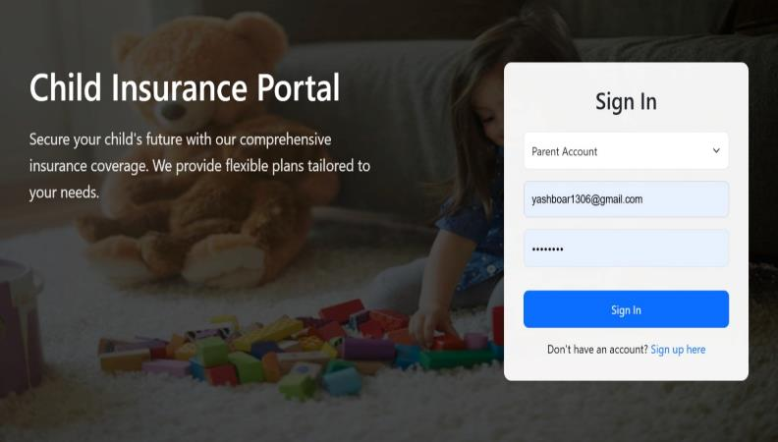
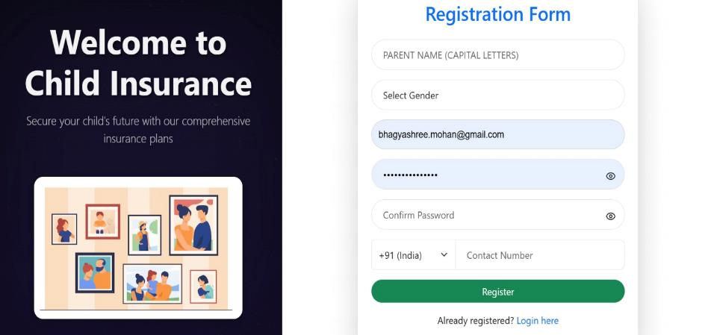
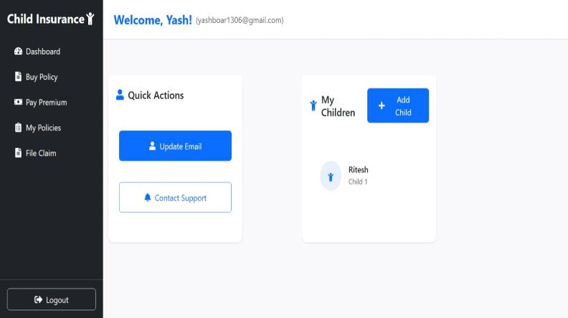
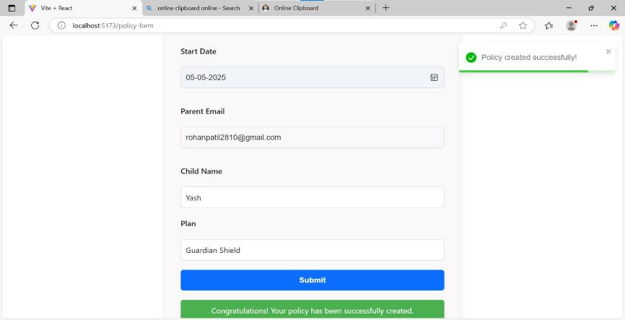
Project Pages And Flow:

Slide 12
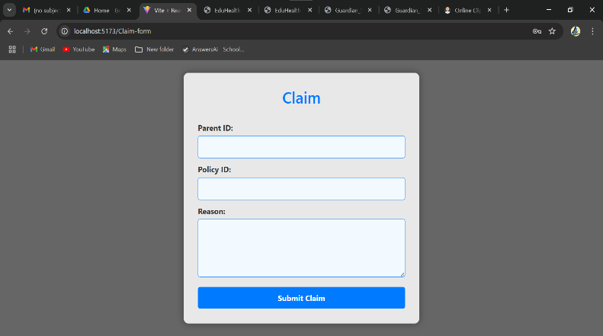
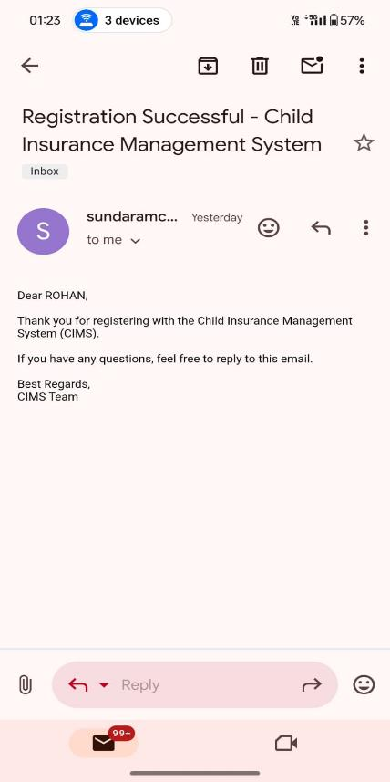
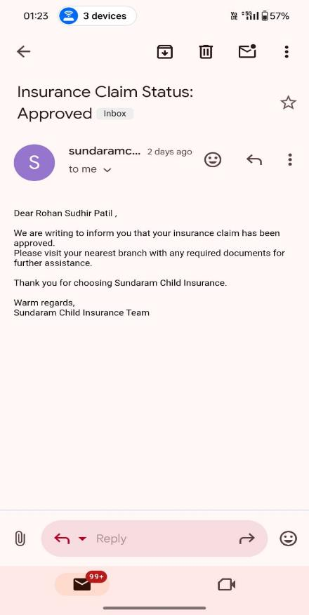
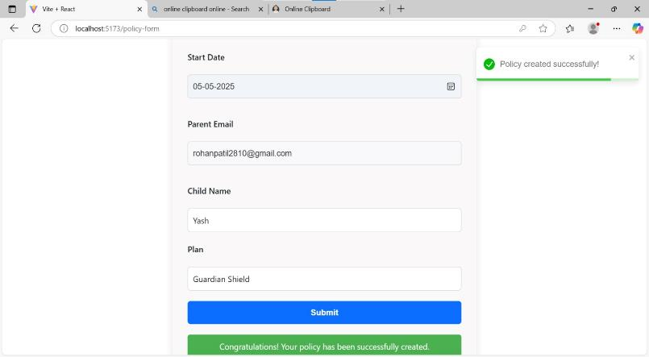
Project Pages And Flow:

Slide 13
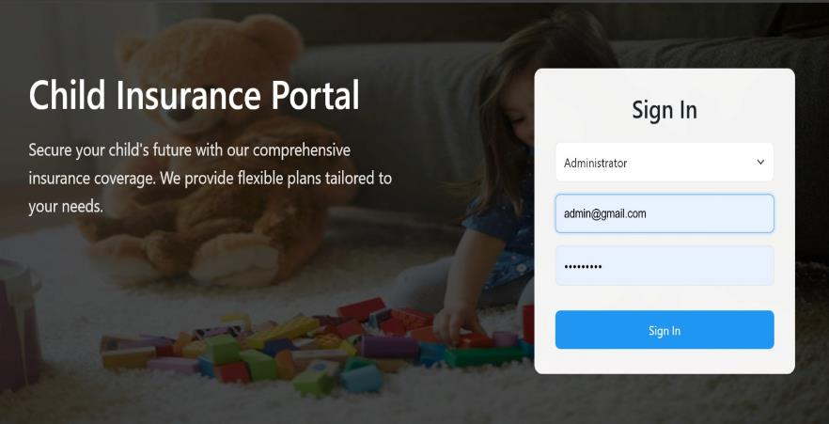
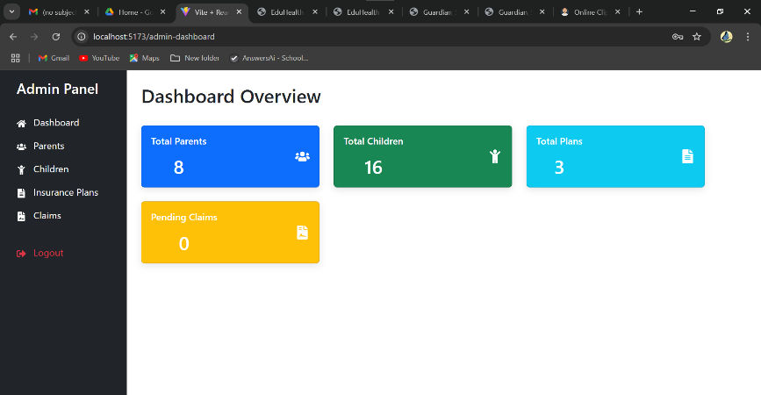
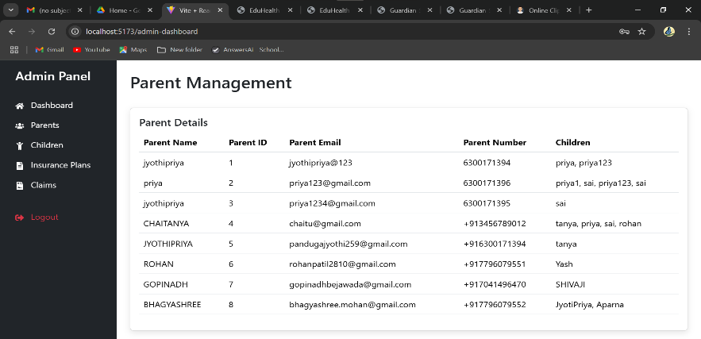
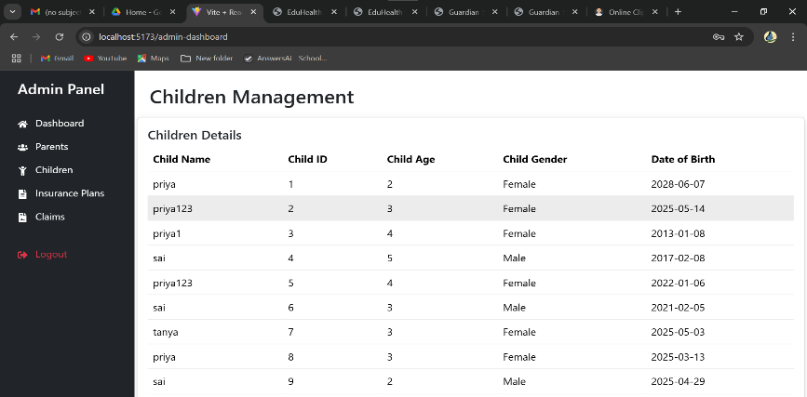
Project Pages And Flow:

Slide 14
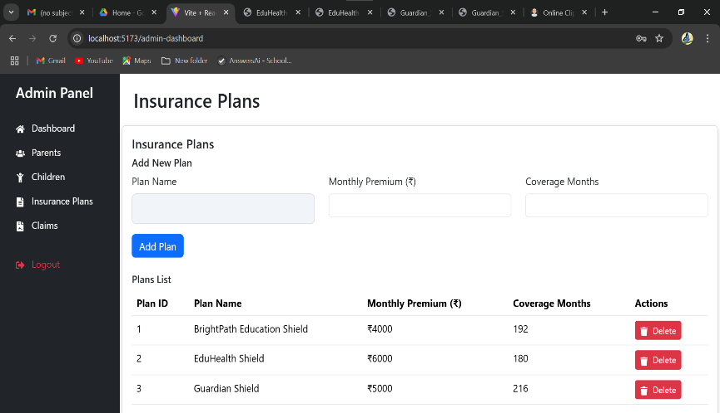
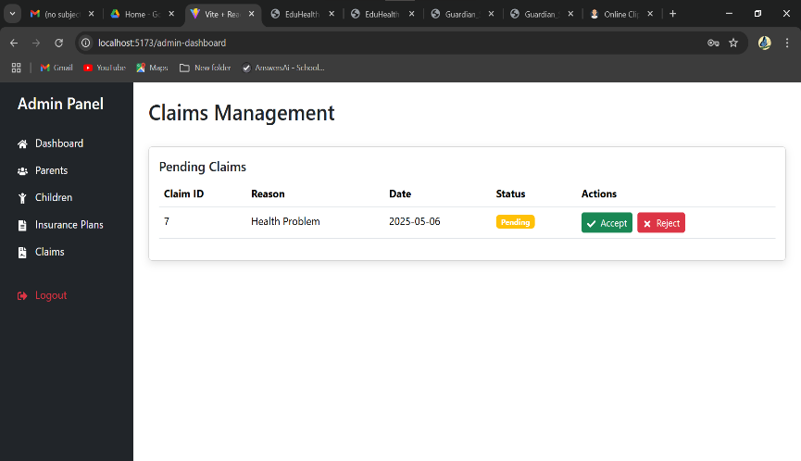
Project Pages And Flow:

Slide 15
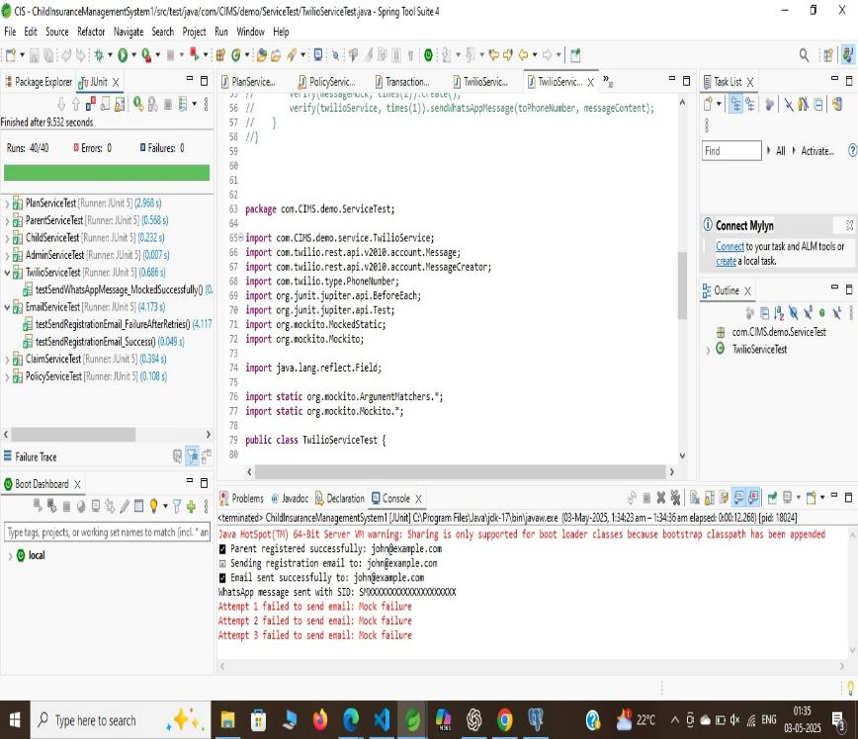
Testing Report:
Backend Testcases:
Frontend Testcases:

Slide 16
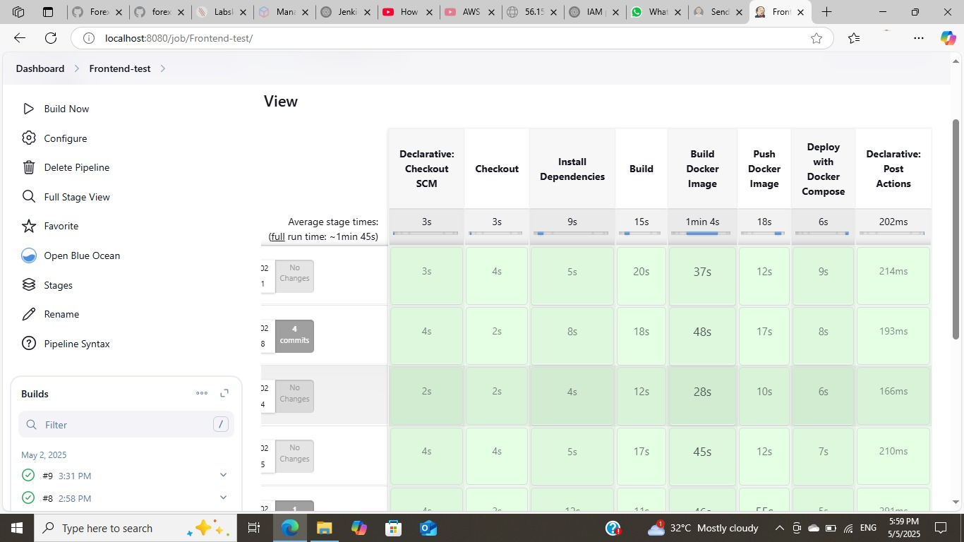
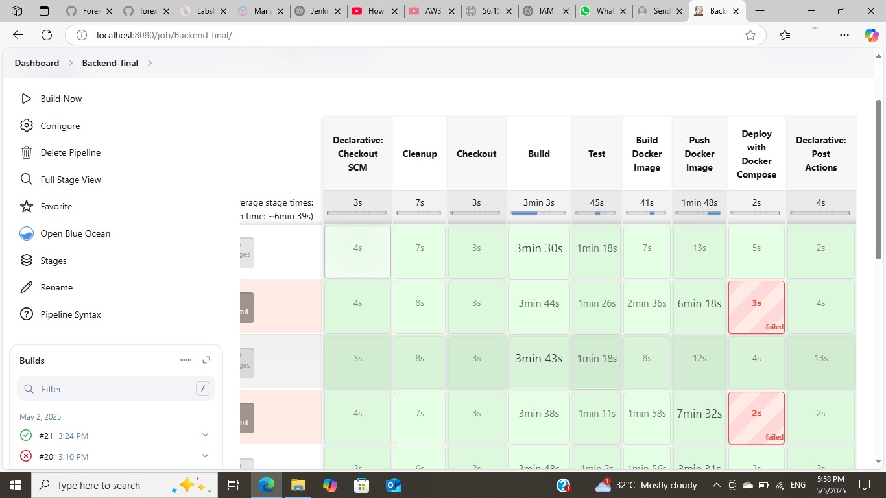
Deployment Flow:
Frontend Jenkins pipeline:
Backend Jenkins pipeline:

Slide 17
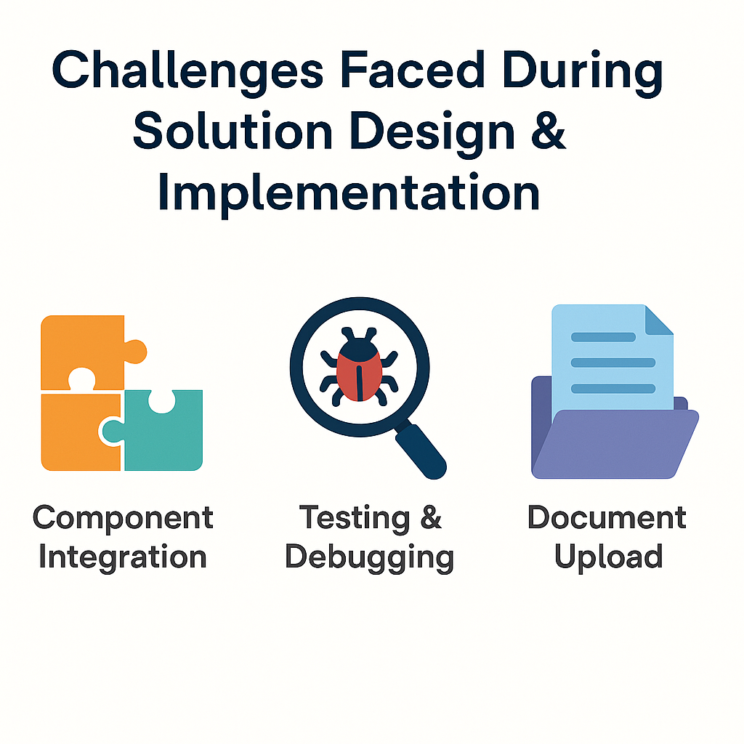

Slide 18
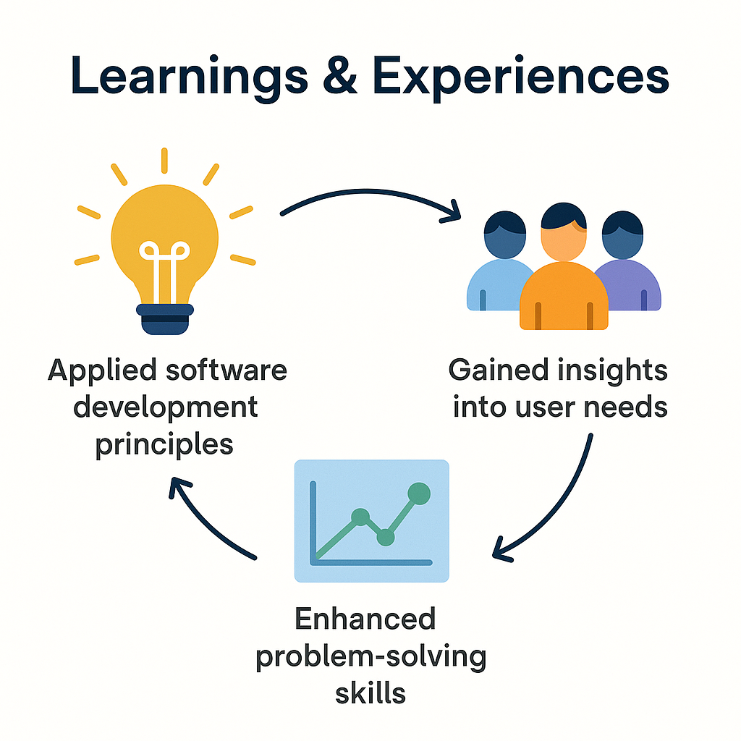

Slide 19
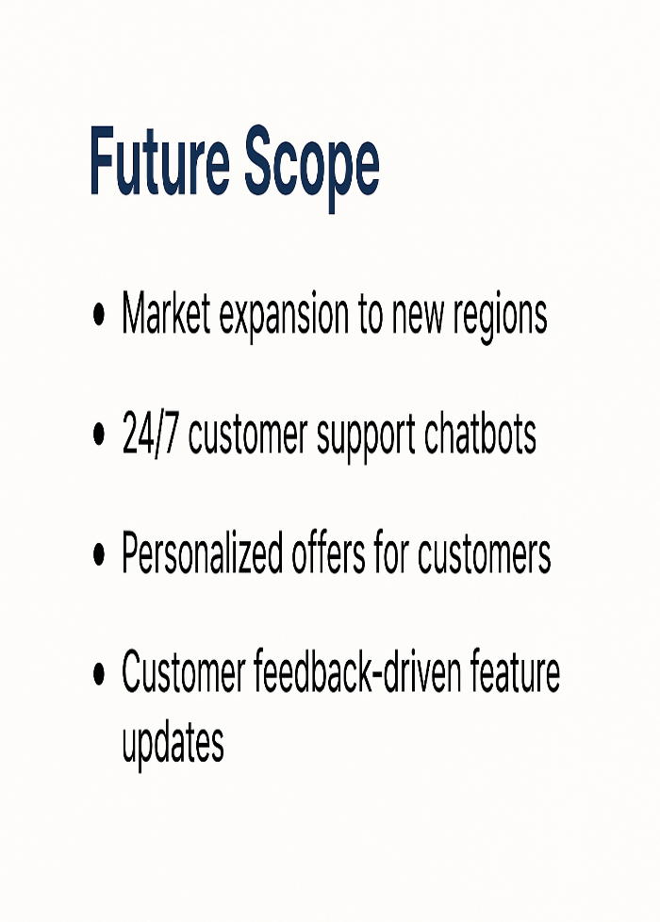
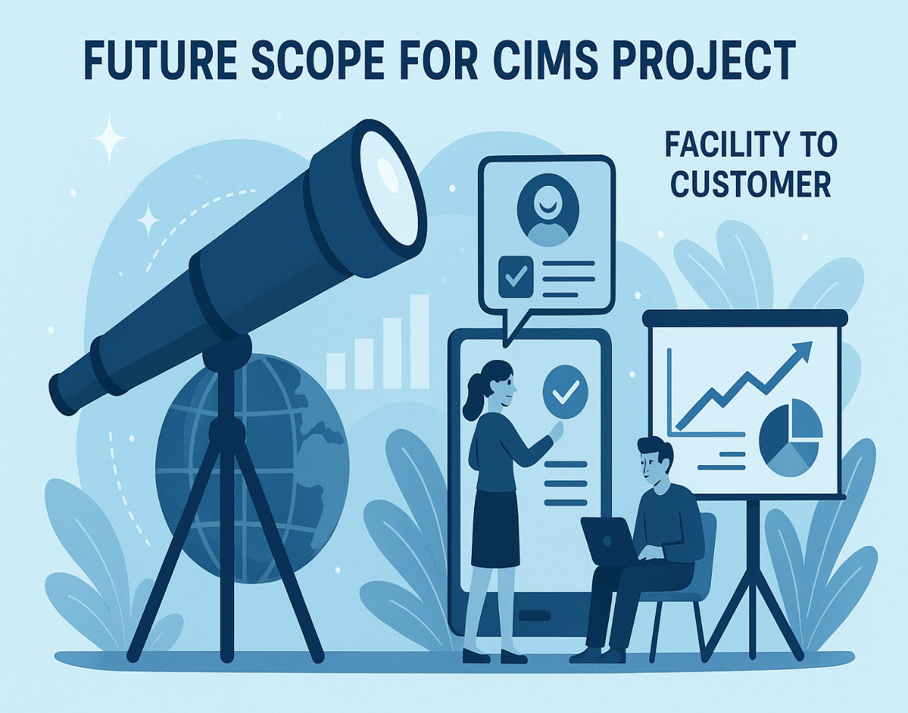

Slide 20
Thank You

